Slide 1
What is inventory management?
Inventory management is the process of efficiently overseeing the flow of goods, products or materials in and out of a business or organization. This includes managing the ordering, storing, tracking and selling of inventory, as well as ensuring that inventory levels are optimal to meet customer demand while minimizing excess inventory and associated costs.
Effective inventory management involves balancing the costs of holding inventory (such as storage, handling and financing costs) with the benefits of having sufficient inventory on hand to meet customer demand and prevent stock outs. It also involves monitoring inventory levels, forecasting demand, and making data-driven decisions to optimize inventory levels, reorder points, and safety stock levels.
Inventory management is an essential function for businesses of all sizes and types, including retail stores, warehouses, manufacturers, and distributors. By maintaining accurate inventory records and using inventory management software, businesses can reduce costs, improve efficiency, and enhance customer satisfaction.

Slide 2
Vendor Managed Inventory (VMI) is a supply chain management practice where the supplier or vendor of goods takes responsibility for managing the inventory levels of the customer. In this system, the vendor monitors the inventory levels of their products at the customer's location, and based on the agreed-upon inventory levels, the vendor ensures that the customer always has the required level of inventory without the customer having to place individual orders.
The vendor typically receives access to the customer's inventory data and then regularly checks the inventory levels to determine the amount of stock to replenish. This ensures that the customer always has the right amount of inventory to meet their needs while reducing the risk of stock outs and overstocking. VMI is typically used in industries where there is a high volume of inventory turnover, such as retail, manufacturing, and automotive industries. VMI can help improve efficiency, reduce inventory holding costs, and improve the overall supply chain performance.
In this project, we consider Vendor Managed Inventory (VMI)

Slide 3
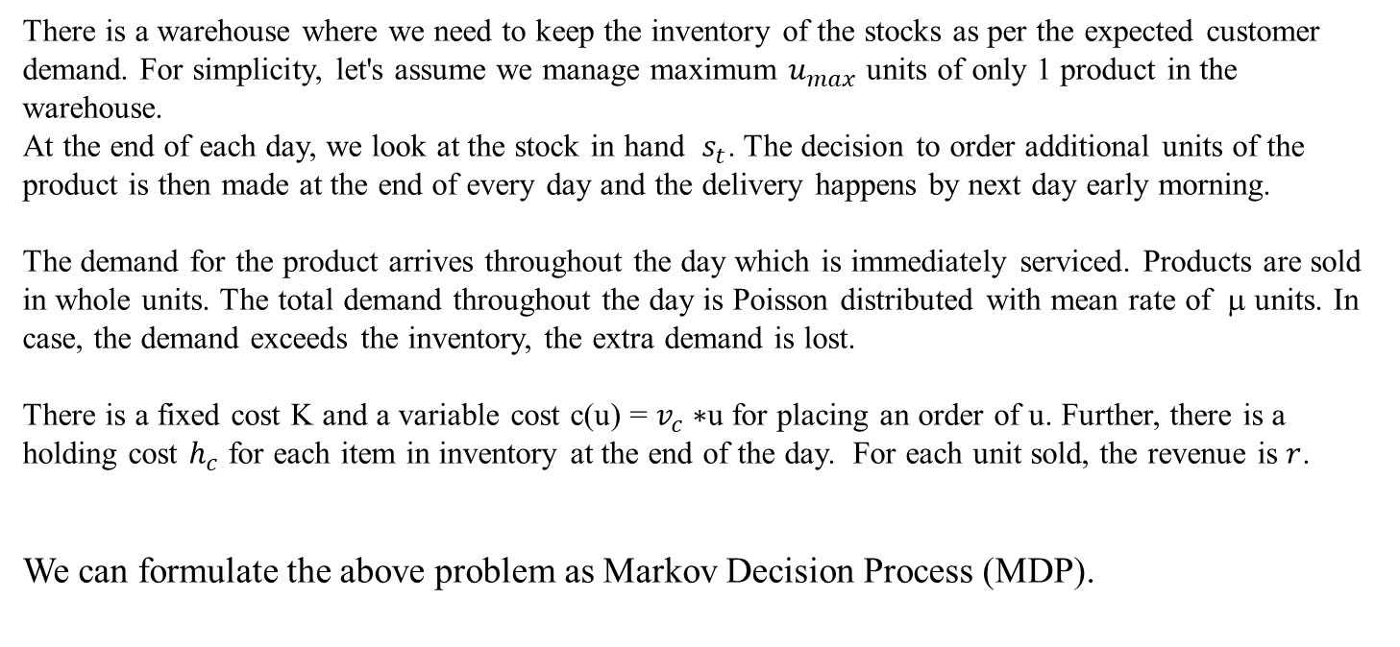
Simple Case : One Warehouse
There is a warehouse where we need to keep the inventory of the stocks as per the expected customer demand. For simplicity, let's assume we manage maximum $u_{max}$ units of only 1 product in the warehouse.
At the end of each day, we look at the stock in hand $s_{t}$. The decision to order additional units of the product is then made at the end of every day and the delivery happens by next day early morning.
The demand for the product arrives throughout the day which is immediately serviced. Products are sold in whole units. The total demand throughout the day is Poisson distributed with mean rate of μ units. In case, the demand exceeds the inventory, the extra demand is lost.
There is a fixed cost K and a variable cost c(u) = $v_{c}∗$u for placing an order of u. Further, there is a holding cost $h_{c}$ for each item in inventory at the end of the day. For each unit sold, the revenue is $r$.
We can formulate the above problem as Markov Decision Process (MDP).

Slide 4
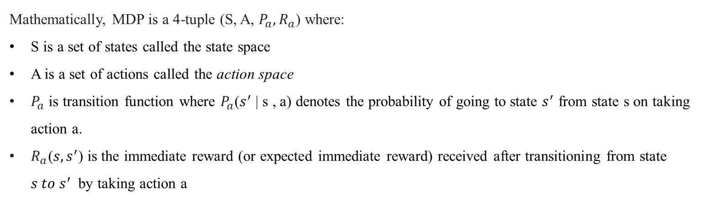
MARKOV DECISION PROCESS (MDP)
Markov decision process (MDP) is a mathematical framework used to model decision-making problems in which outcomes are partially random and partially under the control of a decision-maker.
In an MDP, a decision-maker takes actions in a sequence of states, each of which has a certain probability of leading to other states based on a transition function. The objective is to find a policy that maximizes the expected total reward over a finite or infinite time horizon. The reward function assigns a numerical value to each state, action, and transition based on the desired outcome of the decision-making problem.
Mathematically, MDP is a 4-tuple (S, A, $P_{a}{,R}_{a}$) where:
S is a set of states called the state space
A is a set of actions called the action space
$P_{a}$ is transition function where $P_{a}$($s^{′}$ | s , a) denotes the probability of going to state $s^{′}$ from state s on taking action a.
$R_{a}$(${s,s}^{′}$) is the immediate reward (or expected immediate reward) received after transitioning from state ${s to s}^{′}$by taking action a

Slide 5
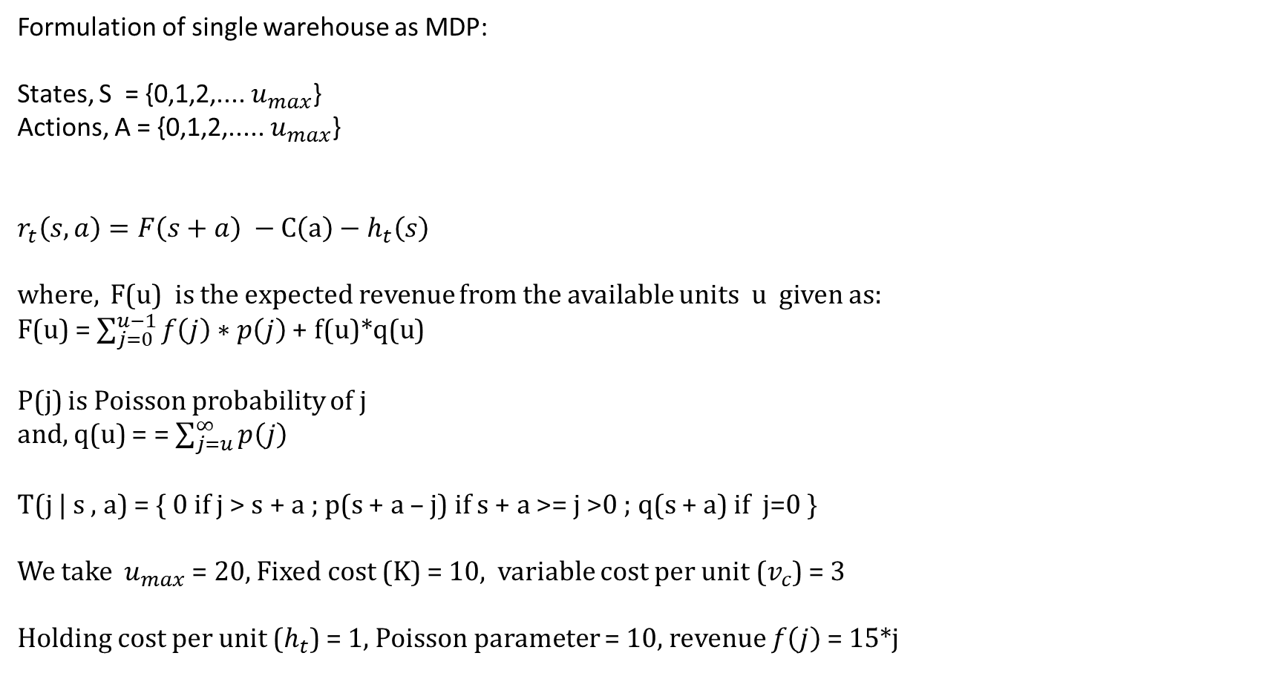
Formulation of single warehouse as MDP:
States, S = {0,1,2,.... $u_{max}$}
Actions, A = {0,1,2,..... $u_{max}$}
$$r_{t}\left(s,a\right)=F\left(s+a\right) −C\left(a\right)−h_{t}\left(s\right)$$
where, F(u) is the expected revenue from the available units u given as: F(u) = $\sum_{j=0}^{u−1}{f\left(j\right)∗p\left(j\right)}$ + f(u)*q(u)
P(j) is Poisson probability of j
and, q(u) = = $\sum_{j=u}^{∞}{p\left(j\right)}$
T(j | s , a) = { 0 if j > s + a ; p(s + a – j) if s + a >= j >0 ; q(s + a) if j=0 }
We take $u_{max}$ = 20, Fixed cost (K) = 10, variable cost per unit ($v_{c}$) = 3
Holding cost per unit ($h_{t}$) = 1, Poisson parameter = 10, revenue $f\left(j\right)$ = 15*j

Slide 6
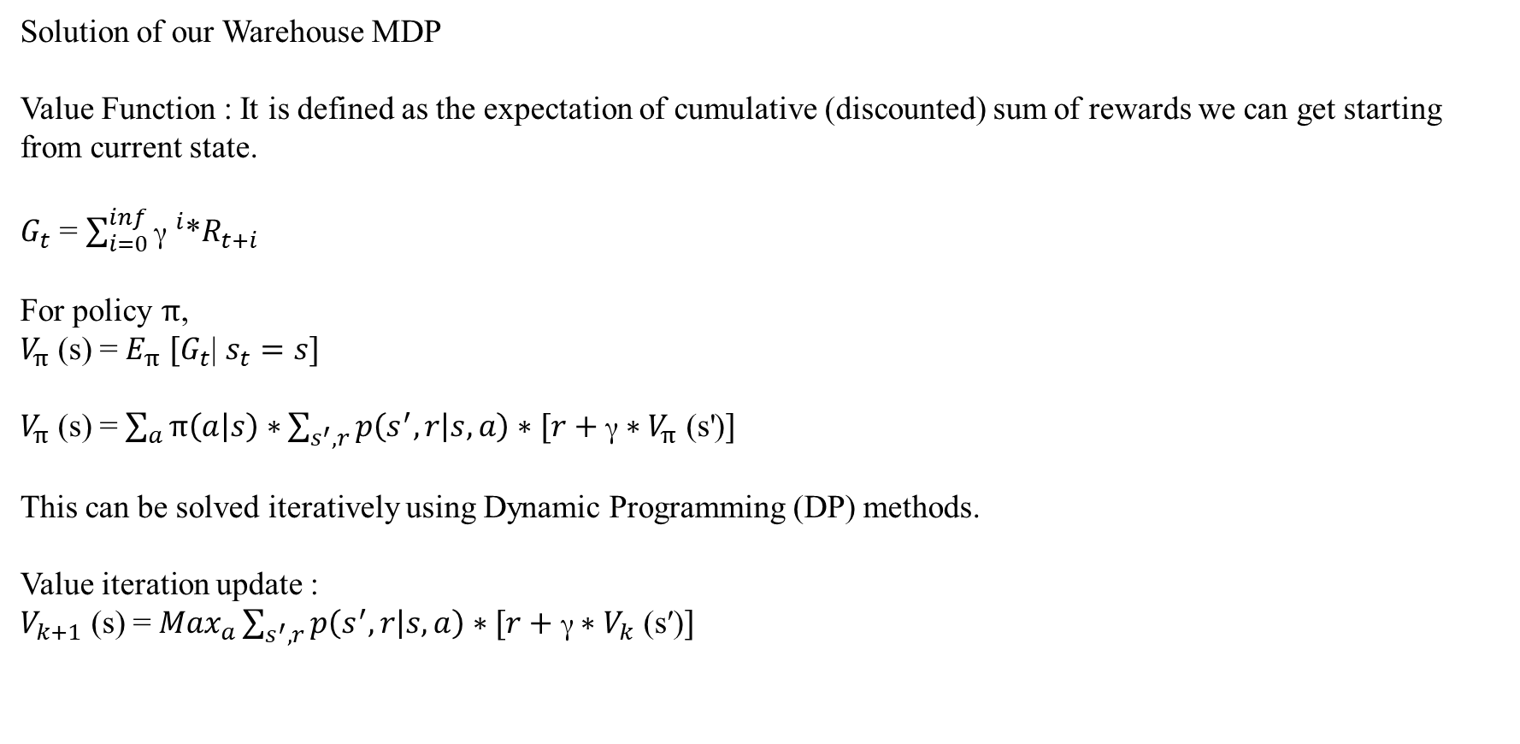
Solution of our Warehouse MDP
Value Function : It is defined as the expectation of cumulative (discounted) sum of rewards we can get starting from current state.
$G_{t}$ = $\sum_{i=0}^{inf}{{\text{γ} }^{i}}$*$R_{t+i}$
For policy $π$,
$V_{π }$(s) = $E_{π} [G_{t}$| $s_{t}=s]$
$V_{π }$(s) = $\sum_{a}{π\left(a | s\right)∗}\sum_{s^{′},r}{p\left(s^{′},r | s,a\right)∗[r+\text{γ}∗V_{π }\text{(}\text{s}\text{′}\text{)}]}$
This can be solved iteratively using Dynamic Programming (DP) methods.
Value iteration update :
$V_{k+1 }$(s) = ${Max}_{a}\sum_{s^{′},r}{p\left(s^{′},r | s,a\right)∗[r+\text{γ}∗V_{k }\text{(}\text{s}\text{′)}]}$

Slide 7
Algorithm (Sutton & Barto)

